Slide 1
REACT NATIVE
Lesson 2: SQLite

Slide 2
SQLite
What is SQLite?
Transaction/executeSQL
Navigating between screens
1-to-many

Slide 3
Create a React Native App with Expo
npx create-expo-app@latest lesson2
npm run reset-project
Remove all files in folders: components (6 tsx), constants (1) and hooks (3)

Slide 4
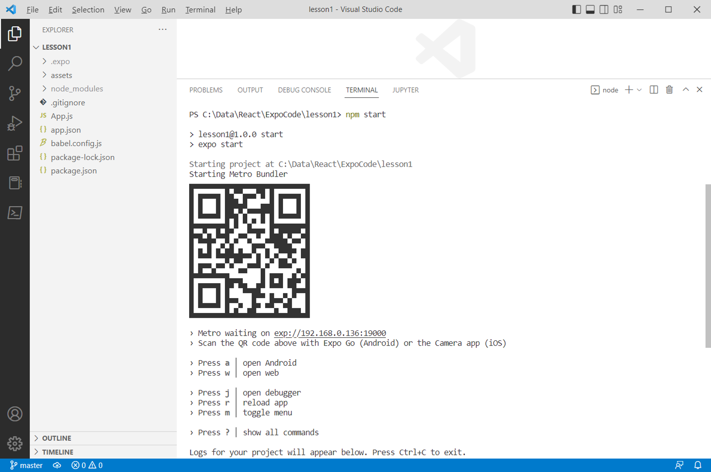
Running your App
npx expo start

Slide 5
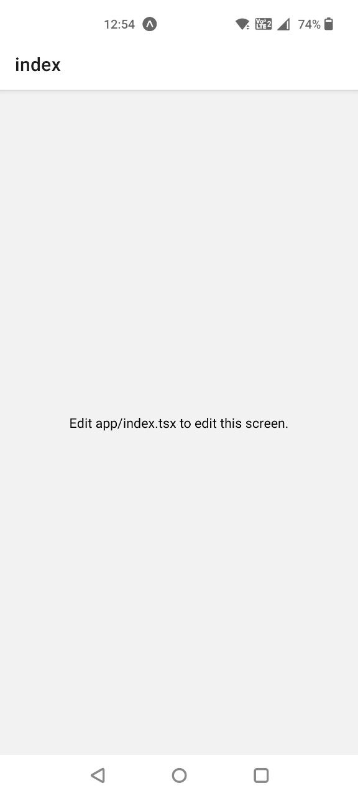

Running on Device
Install the Expo Go app on your iOS or Android phone and connect to the same wireless network as your computer.
On Android, use the Expo Go app to scan the QR code from your terminal to open your project.
On iOS, use the built-in QR code scanner of the default iOS Camera app.

Slide 6
Resources
Copy all components from Resources
Copy index.jsx from Resources to app (delete index.tsx)
Copy usa_db.js from Resources to app

Slide 7

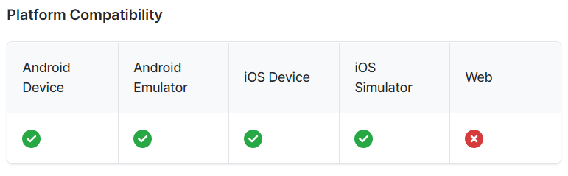
What is SQLite?
SQLite is a library that implements a small, fast, high-reliability, full-featured, SQL database engine.
SQLite is one of the most popular and easy-to-use relational database systems.
SQLite is supported on all mobile phones.
The database is persisted across restarts of your app and only accessible within your app.
npx expo install expo-sqlite

Slide 8
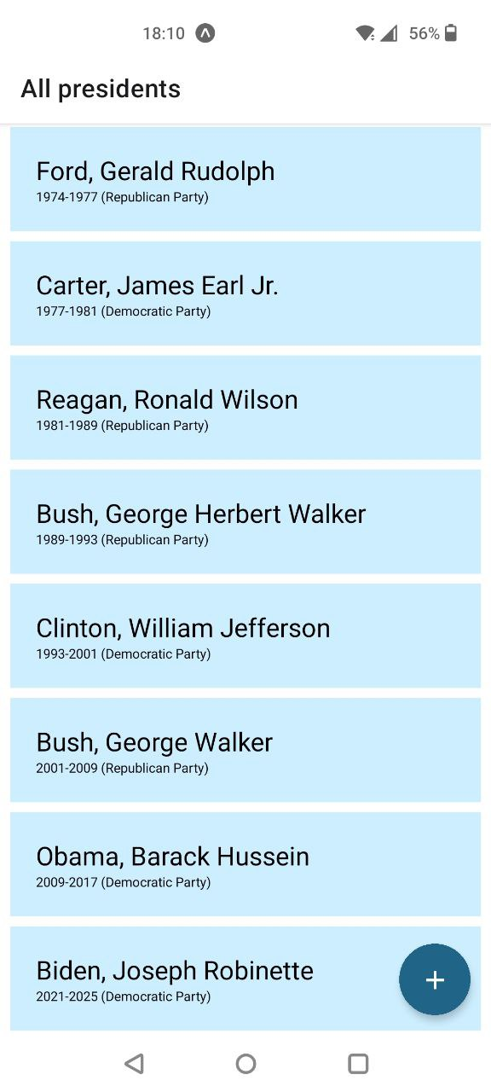
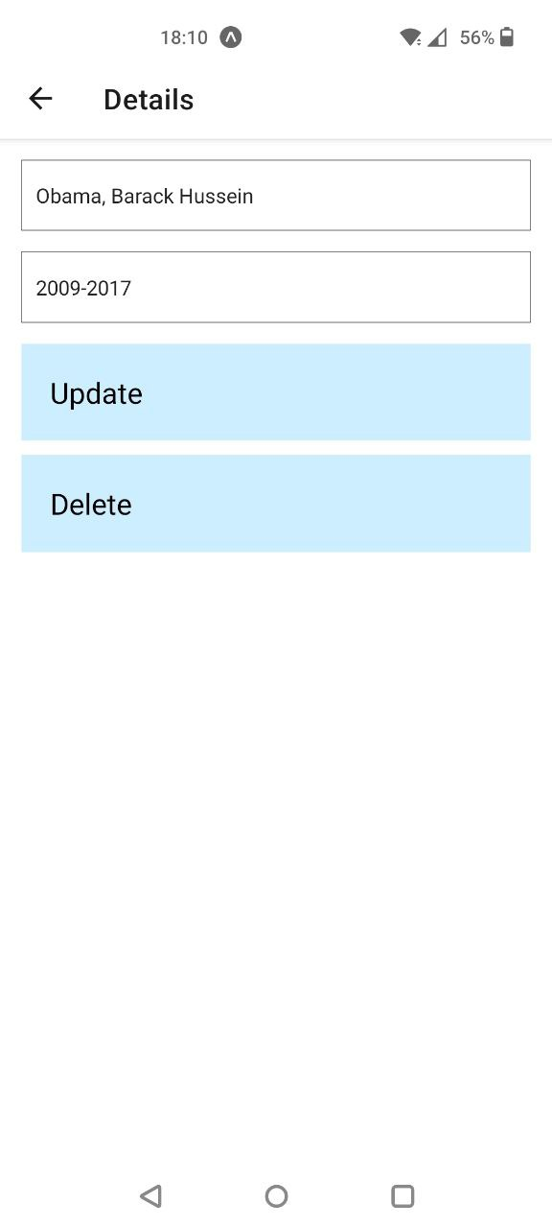
Presidents

Slide 9


Create the database
import * as SQLite from 'expo-sqlite';
const db = SQLite.openDatabase('usa.db');
const version = 1;
export default class UsaDB {
static async initDb() {
if (await this.newerVersionDB(db)) {
this.dropTables(db);
this.createTables(db);
this.createPresidents(db);
console.log('database created with version ' + version);
} else {
console.log('database is already up to date');
}
}

Slide 10
Check if the database is up to date (version)
static create_config_table(db) {
...
"CREATE TABLE IF NOT EXISTS config_table (c_key text primary key, c_value integer);",
static insert_version(db) {
...
"INSERT OR IGNORE INTO config_table (c_key, c_value) VALUES ('version', 0);",
static update_version(db) {
...
"SELECT c_value FROM config_table where c_key = 'version'",
...
if (rows._array[0].c_value != version) {
"UPDATE config_table set c_value = ? where c_key= 'version';", [version]
resolve(true);
} else {
resolve(false);
}
static async newerVersionDB(db) {
await this.create_config_table(db);
await this.insert_version(db);
return await this.update_version(db);
}
c_key | C_value
c_key | C_value
version | 0
c_key | C_value
version | 1

Slide 11
Version 1
static dropTables(db) {
db.transaction((tx) => {
tx.executeSql("DROP TABLE IF EXISTS president");
});
}
static createTables(db) {
db.transaction((tx) => {
tx.executeSql("CREATE TABLE president (id integer primary key AUTOINCREMENT, name text, term text);");
});
}
static createPresidents(db) {
db.transaction((tx) => {
tx.executeSql("INSERT INTO president (name, term) VALUES ('Roosevelt, Franklin Delano', '1933-1945');");
...
}

Slide 12
transaction
db.transaction(callback, errorCallback, successCallback)
callback is a function representing the transaction to perform.
Takes a transaction as its only parameter, on which it can add SQL statements to execute

Slide 13
executeSql
tx.executeSql(sqlStatement, args, callback, errorCallback)
sqlStatement is the SQL query to execute
may contain ? placeholders, with values to be substituted with parameter
args is an array of values to substitute for ? placeholders
callback is called when the query is successfully
two parameters: the transaction itself, and the results of the query
errorCallback is called if an error occurred

Slide 14

initDb
Create the database when starting the App
Why useEffect?
Notes:
import { useEffect } from 'react';
import UsaDB from './usa_db.js';
useEffect(() => {
UsaDB.initDb();
}, []);

Slide 15
usa_db.js
static getPresidents() {
return new Promise((resolve) => { // create a promise
db.transaction((tx) => { // within the transaction tx
tx.executeSql( // execute the SELECT
"SELECT * FROM president",
[], // no parameters
(tx, { rows }) => { // callback function when SELECT is EXECUTED
resolve(rows._array); // fulfill the promise with the result
}
);
});
});
}

Slide 16
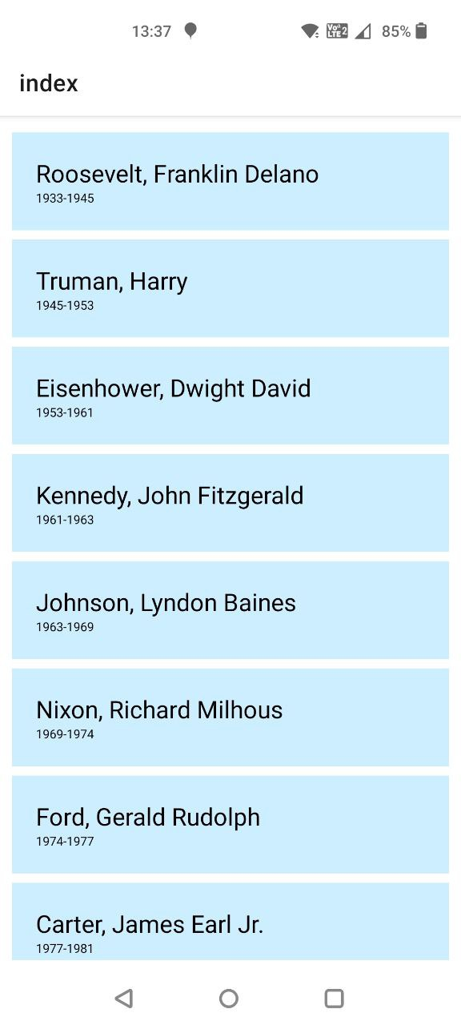
ListPresidents.jsx
Notes:
import { View, StyleSheet, FlatList, TouchableOpacity, Text } from 'react-native';
<FlatList
data={data}
keyExtractor={item => item.id}
renderItem={({ item }) => (
<TouchableOpacity style={styles.item}>
<Text style={styles.name}>{item.name}</Text>
<Text style={styles.term}>{item.term}</Text>
</TouchableOpacity>
)}
/>

Slide 17
Navigating between screens
import ListPresidents from '@/components/ListPresidents';
import DetailsPresident from '@/components/DetailsPresident';
import { createNativeStackNavigator } from '@react-navigation/native-stack';
const Stack = createNativeStackNavigator();
<Stack.Navigator initialRouteName="Home">
<Stack.Screen name="Home" component={HomeScreen} options={{ title: 'All presidents' }} />
<Stack.Screen name="Details" component={DetailsScreen} />
</Stack.Navigator>
Notes:
function HomeScreen({ navigation }) {
return (
<View style={styles.container}>
<ListPresidents navigation={navigation} />
</View>
);
}
function DetailsScreen({ route, navigation }) {
return (
<View style={styles.container}>
<DetailsPresident route={route} navigation={navigation} />
</View>
);
}

Slide 18
React (Native) navigation
the createNativeStackNavigator function returns a Stack object with 2 properties: Screen and Navigator
Within the Navigator, use Screen elements as its children to define the different routes.
route (for arguments) and navigation (to navigate to a screen) props are automatically passed to every screen component.

Slide 19
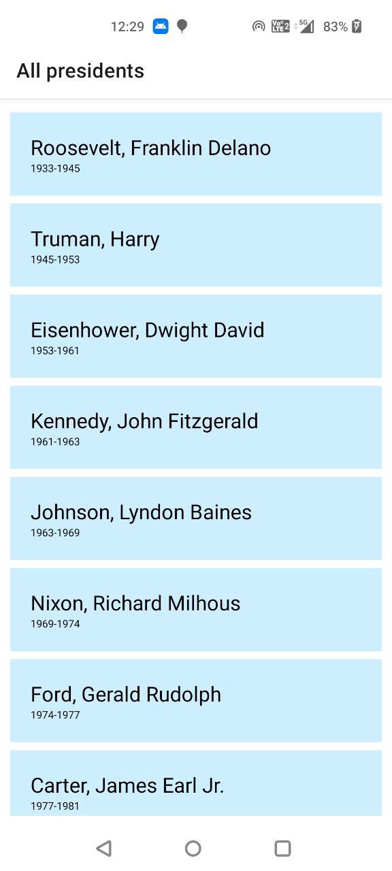
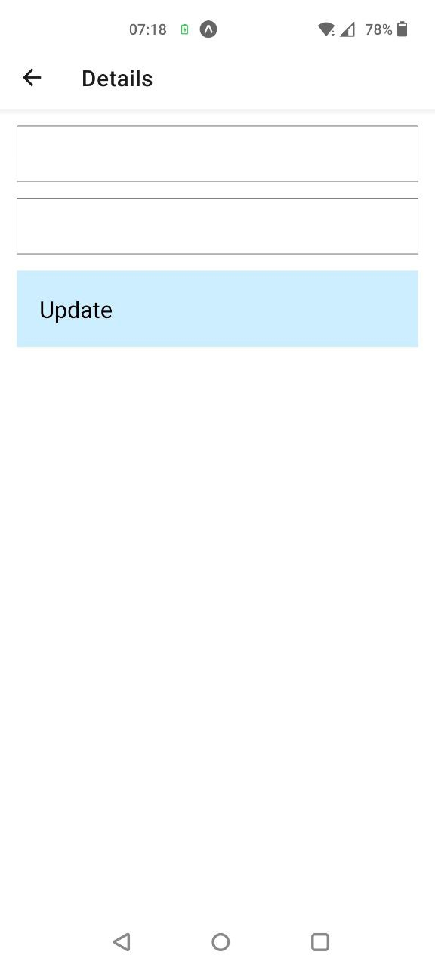
ListPresidents.jsx
Notes:
function handleOnPress(id) {
navigation.navigate('Details', { id: id });
}

Slide 20
DetailsPresident.jsx
export default function DetailsPresident() {
const [president, setPresident] = useState({id: 0, name: '', term: ''});
function handleChangeName(value) {
setPresident({ ...president, name: value });
}
function handleChangeTerm(value) {
setPresident({ ...president, term: value });
}
function handleOnPress() { }
return (
<View style={styles.container}>
<TextInput onChangeText={handleChangeName} style={styles.input} value={president.name} />
<TextInput
onChangeText={handleChangeTerm} style={styles.input} value={president.term} keyboardType='numeric' />
<TouchableOpacity style={styles.button} onPress={handleOnPress}>
<Text style={styles.name}>Update</Text>
</TouchableOpacity>
</View>
);
};

Slide 21
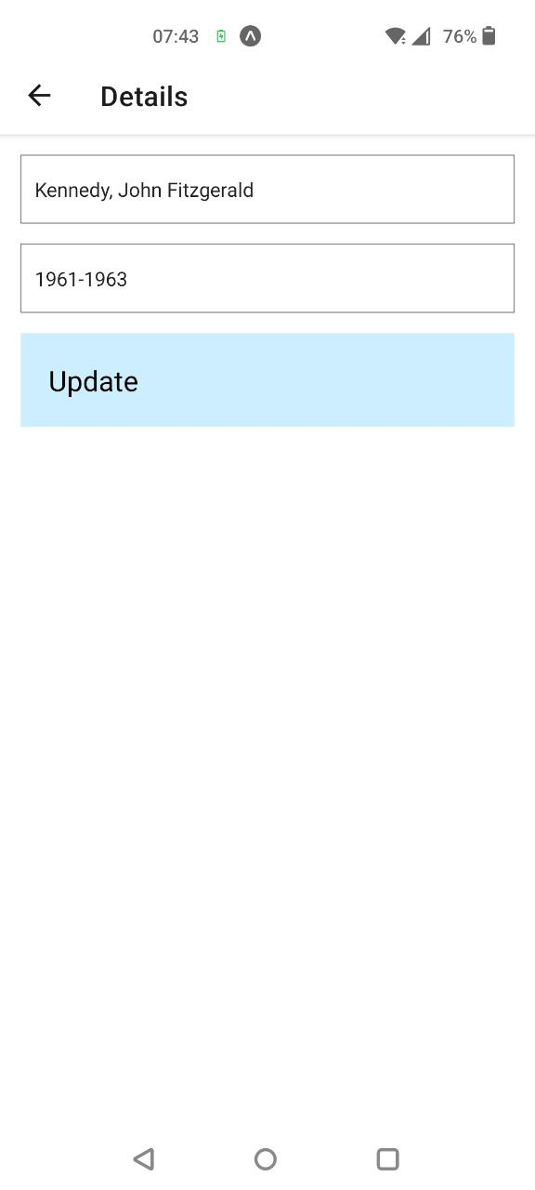
DetailsPresident.jsx
static getPresidentById(id) {
return new Promise((resolve) => {
db.transaction((tx) => {
tx.executeSql(
"SELECT * FROM president WHERE id = ?",
[id],
(tx, { rows }) => {
resolve(rows._array[0]);
}
);
});
});
}
Notes:
const { id } = route.params;

Slide 22
Update
static updatePresident(president) {
return new Promise((resolve) => {
db.transaction((tx) => {
tx.executeSql(
"UPDATE president SET name=?, term=? where id=?",
[president.name, president.term, president.id],
(tx, results) => {
if (results.rowsAffected == 0) {
resolve(false);
} else {
resolve(true);
}
},
() => resolve(false)
);
});
});
}
Notes:
import { useFocusEffect } from '@react-navigation/native';

Slide 23
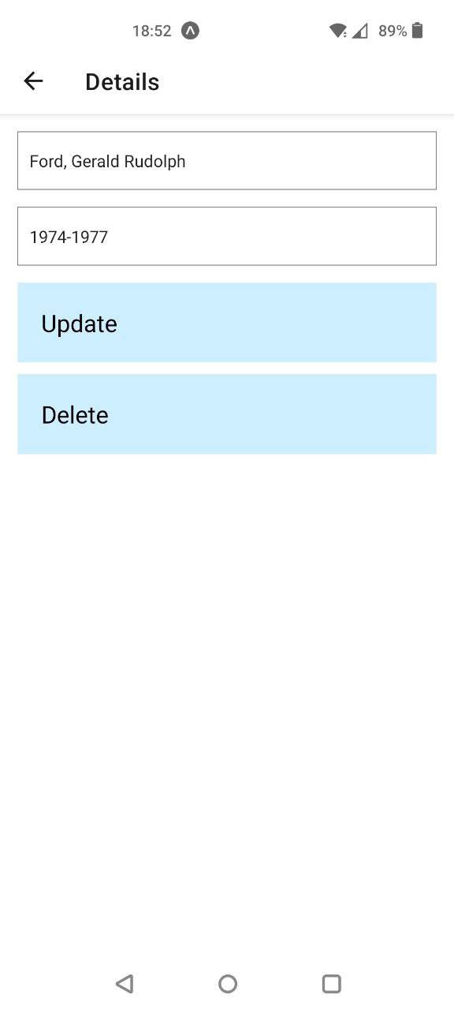
Delete
static deletePresident(id) {
return new Promise((resolve) => {
db.transaction((tx) => {
tx.executeSql(
"DELETE FROM president where id=?",
[id],
(tx, results) => {
if (results.rowsAffected == 0) {
resolve(false);
} else {
resolve(true);
}
},
() => resolve(false)
);
});
});
}

Slide 24
Floating Action Button
npm install react-native-elements
Notes:
import { FAB } from 'react-native-elements';
<FAB
icon={{ name: 'add', color: 'white' }}
size="large"
placement="right"
color="#206587"
onPress={handleInsert}
/>

Slide 25
Insert
static insertPresident(president) {
return new Promise((resolve) => {
db.transaction((tx) => {
tx.executeSql(
"INSERT INTO president (name, term) VALUES (?,?)",
[president.name, president.term],
(tx, results) => {
if (results.rowsAffected == 0) {
resolve(false);
} else {
resolve(true);
}
},
() => resolve(false)
);
});
});
}

Slide 26

Exercise: 1-to-many
president
id (PK)
name
term
partyid (FK)
party
id (PK)
name

Slide 27
Exercise: 1-to-many
static dropTables(db) {
db.transaction((tx) => {
tx.executeSql("DROP TABLE IF EXISTS president");
tx.executeSql("DROP TABLE IF EXISTS party");
});
}
static createTables(db) {
db.transaction((tx) => {
tx.executeSql("CREATE TABLE party (id integer primary key, name text);");
tx.executeSql("CREATE TABLE president (id integer primary key AUTOINCREMENT, name text, term text, partyid integer, FOREIGN KEY(partyid) REFERENCES party(id));");
});
}

Slide 28
Exercise: 1-to-many
static createParties(db) {
db.transaction((tx) => {
tx.executeSql("INSERT INTO party (id, name) VALUES (1, 'Republican Party');");
tx.executeSql("INSERT INTO party (id, name) VALUES (2, 'Democratic Party');");
});
}
static createPresidents(db) {
db.transaction((tx) => {
tx.executeSql("INSERT INTO president (name, term, partyid) VALUES ('Roosevelt, Franklin Delano', '1933-1945', 2);");
});
}
Notes:
tx.executeSql("INSERT INTO president (name, term, partyid) VALUES ('Roosevelt, Franklin Delano', '1933-1945', 2);");
tx.executeSql("INSERT INTO president (name, term, partyid) VALUES ('Truman, Harry', '1945-1953', 2);");
tx.executeSql("INSERT INTO president (name, term, partyid) VALUES ('Eisenhower, Dwight David', '1953-1961', 1);");
tx.executeSql("INSERT INTO president (name, term, partyid) VALUES ('Kennedy, John Fitzgerald', '1961-1963', 2);");
tx.executeSql("INSERT INTO president (name, term, partyid) VALUES ('Johnson, Lyndon Baines', '1963-1969', 2);");
tx.executeSql("INSERT INTO president (name, term, partyid) VALUES ('Nixon, Richard Milhous', '1969-1974', 1);");
tx.executeSql("INSERT INTO president (name, term, partyid) VALUES ('Ford, Gerald Rudolph', '1974-1977', 1);");
tx.executeSql("INSERT INTO president (name, term, partyid) VALUES ('Carter, James Earl Jr.', '1977-1981', 2);");
tx.executeSql("INSERT INTO president (name, term, partyid) VALUES ('Reagan, Ronald Wilson', '1981-1989', 1);");
tx.executeSql("INSERT INTO president (name, term, partyid) VALUES ('Bush, George Herbert Walker', '1989-1993', 1);");
tx.executeSql("INSERT INTO president (name, term, partyid) VALUES ('Clinton, William Jefferson', '1993-2001', 2);");
tx.executeSql("INSERT INTO president (name, term, partyid) VALUES ('Bush, George Walker', '2001-2009', 1);");
tx.executeSql("INSERT INTO president (name, term, partyid) VALUES ('Obama, Barack Hussein', '2009-2017', 2);");
tx.executeSql("INSERT INTO president (name, term, partyid) VALUES ('Trump, Donald John', '2017-2021', 1);");
tx.executeSql("INSERT INTO president (name, term, partyid) VALUES ('Biden, Joseph Robinette', '2021-2025', 2);");

Slide 29

Exercise: 1-to-many
const version = 2;
export default class UsaDB {
static async initDb() {
if (await this.newerVersionDB(db)) {
this.dropTables(db);
this.createTables(db);
this.createParties(db);
this.createPresidents(db);
console.log('database created with version ' + version);
} else {
console.log('database is already up to date');
}
}
useEffect(() => {
UsaDB.initDb();
}, []);

Slide 30
Exercise: 1-to-many
static getPresidents() {
return new Promise((resolve) => { // create a promise
db.transaction((tx) => { // within the transaction tx
tx.executeSql( // execute the SELECT
"SELECT pr.id, pr.name, pr.term, pa.name as party
FROM president pr, party pa where pr.partyid = pa.id",
[], // no parameters
(tx, { rows }) => { // callback function where SELECT is EXECUTED
resolve(rows._array); // fulfill the promise with the result
}
);
});
});
}

Slide 31
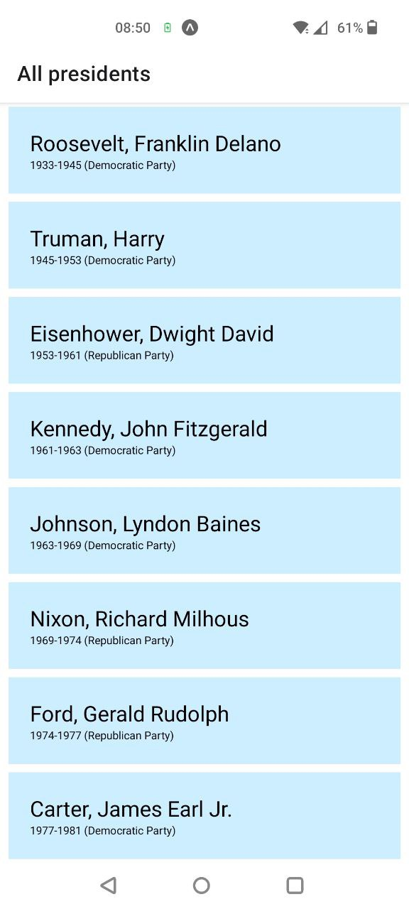
Exercise: 1-to-many
<TouchableOpacity style={styles.item} onPress={() => handleOnPress(item.id)}>
<Text style={styles.name}>{item.name}</Text>
<Text style={styles.term}>{item.term} ({item.party})</Text>
</TouchableOpacity>

Slide 32
Extra Exercise
Use a dropdownlist to select the party in DetailsPresident.jsx
Alter the ListPresidents.jsx component and create a filter on party

